Slide 1
ANALYTICAL CHEMISTRY

Slide 2
INTRODUCTION
Analytical chemistry – Science Field Evolving And Adapting Methods, Devices and strategy for obtaining information about chemical composition, structure and energy state of substances.
Goals of analytical chemistry: to detect chemical elements, which compose particular substance - qualitative analysis; to determine the ratios of different elements in investigative substance - quantitative analysis.

Slide 3
INTRODUCTION
Chemical methods of analysis – methods based on chemical interaction of atoms, molecules and ions. (gravimetry, titrimetry, gas analysis, kinetic methods of analysis).
Physical methods are based on different parameters of substance (radioactivit y, electromagnetic properties, radiation).
biological methods – based on use of biologically active substances and biological systems.
biochemical methods – when substances of biological origin are investigated with chemical methods.

Slide 4
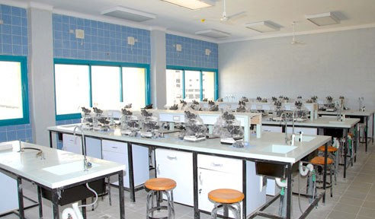
Practical sessions will start immediately after getting the theoretical background in lab

Slide 5
Laboratory Policies
Attendance in the lab is obligatory.
you are allowed to enter the teaching room within the first 10 min of the lab session.
If you miss a lab session, you will NOT be allowed to repeat the missed lab experiment under any circumstances.
you are required to download the week’s experiment and bring the hard copy to the lab, and no excuses will be accepted if you come to the lab without your own copy.
After downloading experimental protocols, you are required to study the lab exercise before coming to the lab to avoid any confusion.

Slide 6
Laboratory Policies
At the end of the lab session, a report with completed lab work will be submitted to the lab instructor.
You should cleanup your work area after the lab experiment and return it back the way you found it.
Every student should bring his own soft tissue paper.
The lab instructor will check your work area before you leave the lab.

Slide 7
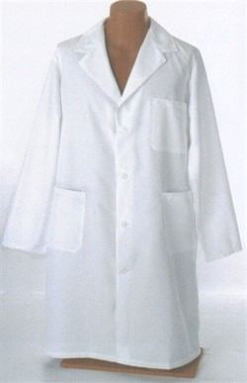
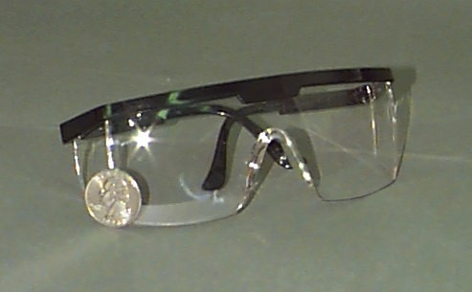
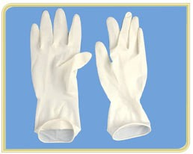
Safety measures & rules
Always wear your lab coat before entering the lab.
Use goggles & gloves if necessary as directed by your lab instructor.

Slide 8
Safety measures & rules
Behave in a respectable and responsible way allover the lab.
Only take your notebook and pen to the lab area; bags, coats, …etc should be kept in your locker.
Mobile phones are allowed in condition to be kept on a silent mode.
Tie up long hair to keep it away from flame.
Do not touch anything from the lab equipment unless told to do so by the lab instructor.
Assume all chemicals in the lab are dangerous.
Do not taste any solution or chemical.

Slide 9
Safety measures & rules
Do not pipette any solution by mouth.
Do not carry reagents around the lab.
No food or drink is allowed in the lab.

Slide 10
Safety measures & rules
Note the position of the safety showers in the lab.
Wash your hands thoroughly before leaving the lab.

Slide 11
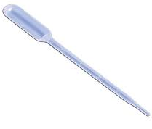
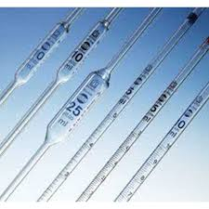
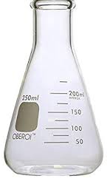
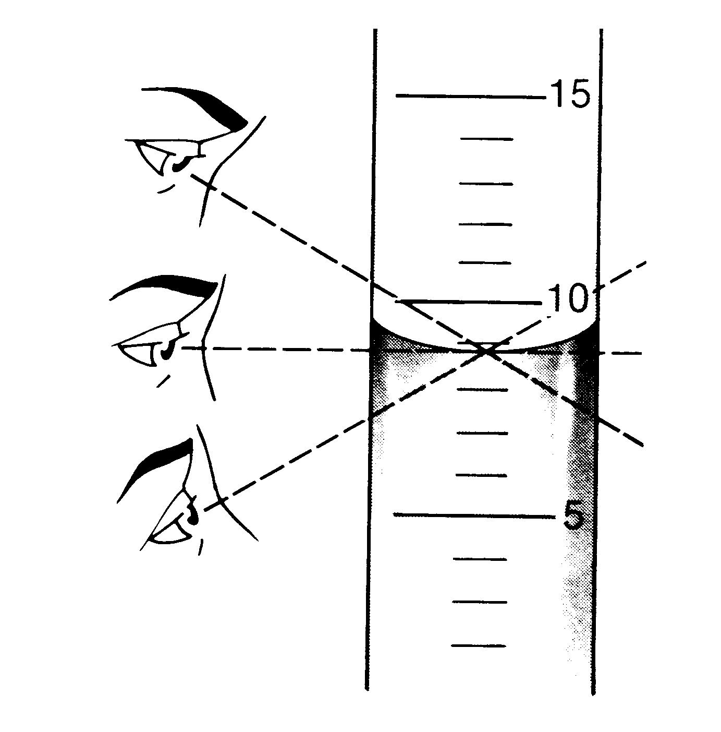
LABORATORY MATERIALS
Pipette
Burette
Flask
Measuring flasks
Wrong
Right
Wrong

